Slide 1
Chapter 5 Introduction to Cascading Style Sheets (CSS)
簡廷因 Ting-Ying Chien
2024.10.16

Slide 2
Outline
Introduction
Text Shadows
Rounded Corners
Color
Box Shadows
Linear Gradients: Introducing Vendor Prefixs
Radial Gradients
Text Stroke
Multiple Background Images
Reflections

Slide 3
Outline
Image Borders
Animation; Selectors
Transitions and Transformations
transition and transform Properties
Skew
Transitioning Between Images
Downloading Web Fonts and the @font-face Rule
Flexible Box Layout Module and :nth-child Selectors
Multicolumn Layout
Media Queries

Slide 4
Web Resource
http://css3clickchart.com/
http://www.westciv.com/tools/gradients/index.html
http://css-infos.net/

Slide 5
Text Shadows
The CSS3 text-shadow property makes it easy to add a text shadow effect to any text.
The text-shadow property has four values
Horizontal offset of the shadow
the number of pixels that the text-shadow will appear to the left or the right of the text.
A negative value moves the text-shadow to the left; a positive value moves it to the right.
Vertical offset of the shadow
the number of pixels that the text-shadow will be shifted up or down from the text.
A negative value moves the shadow up, whereas a positive value moves it down.

Slide 6
Text Shadows
The text-shadow property has four values
blur radius
the blur (in pixels) of the shadow
A blur-radius of 0px would result in a shadow with a sharp edge (no blur).
The greater the value, the greater the blurring of the edges.
Color
determines the color of the text-shadow.

Slide 7




Text Shadows
<!DOCTYPE html>
<html>
<head>
<meta charset = "utf-8">
<title>Text Shadow</title>
<style type = "text/css">
h1
{
text-shadow: -4px 4px 6px dimgrey;
font-size: 400%;
}
</style>
</head>
<body>
<h1>Text Shadow</h1>
</body>
</html>
text-shadow: -4px 4px 6px dimgrey
text-shadow: -40px 40px 6px dimgrey
text-shadow: -40px 40px 20px dimgrey
text-shadow: X 軸方向的陰影 Y 軸方向的陰影 模糊範圍 陰影顏色;
text-shadow: -40px 40px 6px blue

Slide 8
Rounded Corners
The border-radius property allows you to add rounded corners to an element.
Any border-radius value greater than half of the shortest side length produces a completely round end.
You can also specify the radius for each corner with border-top-left-radius, border-top-right-radius, border-bottom-left-radius and border-bottom-right-radius.
Web resource
http://www.cssportal.com/css3-rounded-corner/

Slide 9
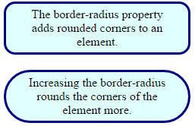

Rounded Corners
<!DOCTYPE html>
<html>
<head>
<meta charset = "utf-8">
<title>Rounded Corners</title>
<style type = "text/css">
div
{
border: 3px solid navy;
padding: 5px 20px;
background: lightcyan;
width: 200px;
text-align: center;
border-radius: 15px;
margin-bottom: 20px;
}
#round2
{
border-radius: 50px;
}
</style>
</head>
<body>
<div>The border-radius property adds rounded corners to an element.</div>
<div id = "round2">Increasing the border-radius rounds the corners
of the element more.</div>
</body>
</html>
border-top-left-radius: 10px;
border-top-right-radius: 20px;
border-bottom-left-radius: 30px;
border-bottom-right-radius: 40px;

Slide 10
Color
CSS3 allows you to express color in several ways
standard color names (such as Aqua)
hexadecimal RGB values (such as #00FFFF for Aqua).
RGB (Red, Green, Blue)
RGBA (Red, Green, Blue, Alpha)
The value for each color - red, green and blue - can range from 0 to 255.
The alpha value - which represents opacity - can be any value in the range 0.0 (fully transparent) through 1.0 (fully opaque).

Slide 11
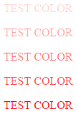
Color
<!DOCTYPE html>
<html>
<head>
<meta charset = "utf-8">
<title>TEST COLOR</title>
</head>
<body>
<p style ="color : rgba(255,0,0,0.2);"> TEST COLOR</p>
<p style ="color : rgba(255,0,0,0.4);"> TEST COLOR</p>
<p style ="color : rgba(255,0,0,0.6);"> TEST COLOR</p>
<p style ="color : rgba(255,0,0,0.8);"> TEST COLOR</p>
<p style ="color : rgba(255,0,0,1);"> TEST COLOR</p>
</body>
</html>

Slide 12
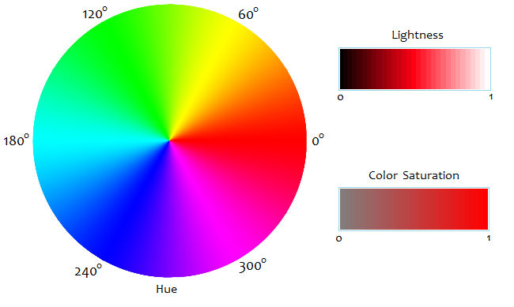
Color
CSS3 also allows you to express color using HSL (hue, saturation, lightness) or HSLA (hue, saturation, lightness, alpha) values.
hue : 色相
saturation : 飽和度
lightness : 亮度
Ref :http://www.had2know.com/technology/hsl-rgb-color-converter.html

Slide 13
Color
The hue is a color or shade expressed as a value from 0 to 359 representing the degrees on a color wheel (a wheel is 360 degrees).
The colors on the wheel progress in the order of the colors of the rainbow—red, orange, yellow, green, blue, indigo and violet.
The value for red, which is at the beginning of the wheel, is 0.

Slide 14
Color
The saturation(the intensity of the hue) is expressed as a percentage, where 100% is fully saturated (the full color) and 0% is gray.
The lightness(the intensity of light or luminance of the hue) is also expressed as a percentage.
A lightness of 50% is the actual hue.

Slide 15
Color
Converter
http://www.rapidtables.com/convert/color/hsl-to-rgb.htm
http://www.rapidtables.com/convert/color/rgb-to-hsl.htm
Web Resource
http://www.w3.org/TR/2003/CR-css3-color-20030514/#hsl-color

Slide 16
Box Shadows
You can shadow any block-level element in CSS3.
The box-shadow property has four values
Horizontal offset of the shadow
the number of pixels that the box-shadow will appear to the left or the right of the box.
A positive value moves the box-shadow to the right
Vertical offset of the shadow
the number of pixels the box-shadow will be shifted up or down from the box.
A positive value moves the box-shadow down.

Slide 17
Box Shadows
The box-shadow property has four values
Blur radius
A blur-radius of 0px would result in a shadow with a sharp edge (no blur).
The greater the value, the more the edges of the shadow are blurred.
Color
the box-shadow’s color.

Slide 18
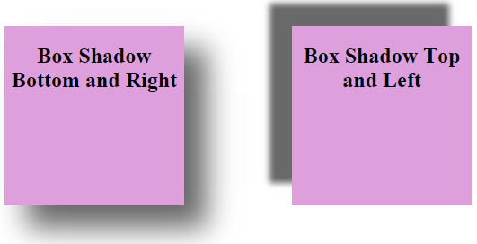
Box Shadows
<!DOCTYPE html>
<html>
<head>
<meta charset = "utf-8">
<title>Box Shadow</title>
<style type = "text/css">
div
{
width: 200px;
height: 200px;
background-color: plum;
box-shadow: 25px 25px 50px dimgrey;
float: left;
margin-right: 120px;
margin-top: 40px;
}
#box2
{
box-shadow: -25px -25px 10px dimgrey;
}
h2
{
text-align: center;
}
</style>
</head>
<body>
<div><h2>Box Shadow Bottom and Right</h2></div>
<div id = "box2"><h2>Box Shadow Top and Left</h2></div>
</body>
</html>

Slide 19



Exercise
a div
{
border: 3px solid navy;
padding: 5px 20px;
background: lightcyan;
width: 100px;
text-align: center;
…
}
a:hover div
{
box-shadow: …
}
a:active div
{
…
}
<a href="#"><div>Click</div></a>

Slide 20
Linear Gradients
Linear gradients are a type of image that gradually transitions from one color to the next horizontally, vertically or diagonally.
You can transition between as many colors as you like and specify the points at which to change colors, called color-stops, represented in pixels or percentages along the gradient line—the angle at which the gradient extends.
You can use gradients in any property that accepts an image.
Web Resource
https://cssgradient.io/

Slide 21
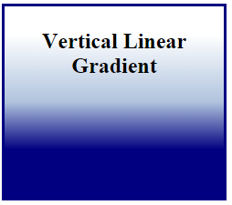
Linear Gradients (Vertical Linear Gradient)
<!DOCTYPE html>
<html>
<head>
<meta charset = "utf-8">
<title>Linear Gradient</title>
<style type = "text/css">
div
{
width: 200px;
height: 200px;
border: 3px solid navy;
padding: 5px 20px;
text-align: center;
background: -webkit-gradient(
linear, center top, center bottom,
color-stop(15%, White), color-stop(50%, lightsteelblue),
color-stop(75%, navy) );
background: -moz-linear-gradient(
top center, white 15%, lightsteelblue 50%, navy 75% );
background: linear-gradient(
top, White 15%, lightsteelblue 50%, navy 75% );
float: left;
margin-right: 15px;
}
</style>
</head>
<body>
<div><h2>Vertical Linear Gradient</h2></div>
</body>
</html>
15%
white
50%
lightsteelblue
navy
75%

Slide 22
Linear Gradients (Webkit)
background: -webkit-gradient(
linear, center top, center bottom,
color-stop(15%, White), color-stop(50%, lightsteelblue),
color-stop(75%, navy) );
-webkit-gradient(<type>, <point1> [, <radius>]?, <point2> [, <radius>]? [, <stop>]*)
<type> : linear or radial
<point1> : a pair of space-separated values (from)
<point2> : a pair of space-separated values (to)
<radius> : a number and may only be specified when the gradient type is radial.
<stop> : from (color)
color-stop (stop value, color)
to (color)
Ref : https://www.webkit.org/blog/175/introducing-css-gradients/

Slide 23
Linear Gradients (Mozilla)
background: -moz-linear-gradient(
top center, white 15%, lightsteelblue 50%, navy 75% );
-moz-linear-gradient([ [ [top | bottom] || [left | right] ],]? <color-stop>[, <color-stop>]+);

Slide 24
Linear Gradients (Standard)
background: linear-gradient(
top, White 15%, lightsteelblue 50%, navy 75% );
linear-gradient( [ <angle> | <side-or-corner>,]? <color-stop>[, <color-stop>]+);
linear-gradient( [ <angle> | to <side-or-corner> ,]? <color-stop> [, <color-stop>]+ )
<side-or-corner> = [left | right] || [top | bottom]
<color-stop> = <color> [ <percentage> | <length> ]?

Slide 25
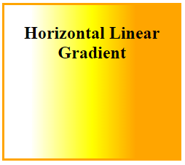
Linear Gradients (Horizontal Linear Gradient)
<!DOCTYPE html>
<html>
<head>
<meta charset = "utf-8">
<title>Linear Gradient</title>
<style type = "text/css">
div
{
width: 200px;
height: 200px;
border: 3px solid orange;
padding: 5px 20px;
text-align: center;
background: -webkit-gradient(
linear, left top, right top,
color-stop(15%, white), color-stop(50%, yellow),
color-stop(75%, orange) );
background: -moz-linear-gradient(
left, white 15%, yellow 50%, orange 75% );
background: linear-gradient(
left, white 15%, yellow 50%, orange 75% );
margin-right: 15px;
}
</style>
</head>
<body>
<div><h2>Horizontal Linear Gradient</h2></div>
</body>
</html>

Slide 26
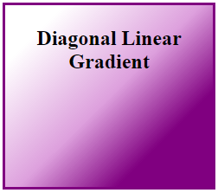
Linear Gradients (Diagonal Linear Gradient)
<!DOCTYPE html>
<html>
<head>
<meta charset = "utf-8">
<title>Linear Gradient</title>
<style type = "text/css">
div
{
width: 200px;
height: 200px;
border: 3px solid purple;
padding: 5px 20px;
text-align: center;
background: -webkit-gradient(
linear, left top, right bottom,
color-stop(15%, white), color-stop(50%, plum),
color-stop(75%, purple) );
background: -moz-linear-gradient(
top left, white 15%, plum 50%, purple 75% );
background: linear-gradient(
135deg, white 15%, plum 50%, purple 75% );
}
</style>
</head>
<body>
<div><h2>Diagonal Linear Gradient</h2></div>
</body>
</html>

Slide 27
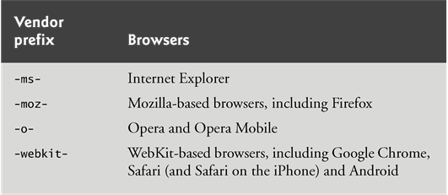
Introducing Vendor Prefixes
Vendor prefixes are used for properties that are still being finalized in the CSS specification but have already been implemented in various browsers.

Slide 28
Introducing Vendor Prefixes
Prefixes are not available for every browser or for every property.
If we remove the prefixed versions of the linear gradient styles in this example, the gradients will not appear when the page is rendered in a WebKit-based browser or Firefox.
As the CSS3 features are finalized and incorporated fully into the browsers, the prefixes will become unnecessary.
Many of the new CSS3 features have not yet been implemented in Internet Explorer.

Slide 29
Introducing Vendor Prefixes
When using vendor prefixes in styles, always place them before the nonprefixed version.
The last version of the style that a given browser supports takes precedence and the browser will use it. By listing the standard non-prefixed version last, the browser will use the standard version over the prefixed version when the standard version is supported.

Slide 30
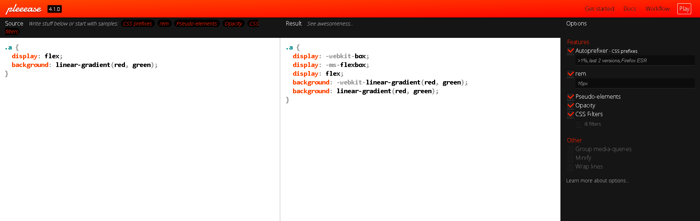
Introducing Vendor Prefixes
vendor prefixes generator
https://autoprefixer.github.io/

Slide 31
Radial Gradients
Radial gradients are similar to linear gradients, but the color changes gradually from an inner point (the start) to an outer circle (the end).
radial-gradient property has three values
position of the start
top, bottom, left, right, center
start color
end color

Slide 32


Radial Gradients
<!DOCTYPE html>
<html>
<head>
<meta charset = "utf-8">
<title>Radial Gradient</title>
<style type = "text/css">
div
{
width: 200px;
height: 200px;
padding: 5px;
text-align: center;
background: -webkit-radial-gradient(center, yellow, red);
background: -moz-radial-gradient(center, yellow, red);
background: radial-gradient(center, yellow, red);
}
</style>
</head>
<body>
<div><h2>Radial Gradient</h2></div>
</body>
</html>
-webkit-radial-gradient(top left, yellow, red);

Slide 33
Text Stroke
The -webkit-text-stroke property is a nonstandard property for WebKit-based browsers that allows you to add an outline (text stroke) around text.
An experimental CSS property in webkit
-webkit-text-stroke with two values
the outline thickness
the color of the text stroke
Web Resource
https://css-tricks.com/almanac/properties/t/text-stroke/

Slide 34


Text Stroke
<!DOCTYPE html>
<html>
<head>
<meta charset = "utf-8">
<title>Text Stroke</title>
<style type = "text/css">
h1
{
color: lightcyan;
-webkit-text-stroke: 2px black;
font-size: 500%;
}
</style>
</head>
<body>
<h1>Text Stroke</h1>
</body>
</html>
color: yellow;
-webkit-text-stroke: 5px red;

Slide 35
Multiple Background Images
CSS3 allows you to add multiple background images to an element.
The comma-separated list of values matches the order of the comma-separated list of images in the background-image property.
The first is on top and they go down from there.
The background-origin determines where each image is placed .

Slide 36

Multiple Background Images
<!DOCTYPE html>
<html>
<head>
<meta charset = "utf-8">
<title>Multiple Backgrounds</title>
<style type = "text/css">
div.background
{
background-image: url(logo.png), url(ocean.png);
background-position: bottom right, 100% center;
background-origin: border-box, content-box;
background-repeat: no-repeat, repeat;
}
div.content
{
padding: 10px 15px;
color: white;
font-size: 150%;
}
</style>
</head>
<body>
<div class = "background">
<div class = "content">
<p>Deitel & Associates, Inc., is an internationally recognized
authoring and corporate training organization. The company
offers instructor-led courses delivered at client sites
worldwide on programming languages and other software topics
such as C++, Visual C++<sup>&reg;</sup>, C, Java&trade;,
C#<sup>&reg;</sup>, Visual Basic<sup>&reg;</sup>,
Objective-C<sup>&reg;</sup>, XML<sup>&reg;</sup>,
Python<sup>&reg;</sup>, JavaScript, object technology,
Internet and web programming, and Android and iPhone app
development.</p>
</div></div>
</body>
</html>

Slide 37

<!DOCTYPE html>
<html>
<head>
<meta charset = "utf-8">
<title>Multiple Backgrounds</title>
<style type = "text/css">
div.background
{
background-image: url(logo.png), url(ocean.png);
background-position: bottom right, 100% center;
background-origin: content-box, border-box;
background-repeat: no-repeat, repeat;
border: 5px solid red;
padding : 20px 40px 60px 80px;
}
div.content
{
padding: 10px 15px;
color: white;
font-size: 150%;
border: 5px solid yellow;
}
</style>
</head>
<body>
<div class = "background">
<div class = "content">
<p>Deitel & Associates, Inc., is an internationally recognized authoring and corporate training organization. The company offers instructor-led courses delivered at client sites worldwide on programming languages and other software topics such as C++, Visual C++ <sup>&reg;</sup>, C, Java&trade;, C#<sup>&reg;</sup>, Visual Basic<sup>&reg;</sup>, Objective-C<sup>&reg;</sup>, XML<sup>&reg;</sup>, Python<sup>&reg;</sup>, JavaScript, object technology, Internet and web programming, and Android and iPhone app development.</p>
</div></div>
</body>
</html>

Slide 38
Multiple Background Images
background-origin
padding-box
The background image is positioned relative to the padding box
border-box
The background image is positioned relative to the border box
content-box
The background image is positioned relative to the content box

Slide 39
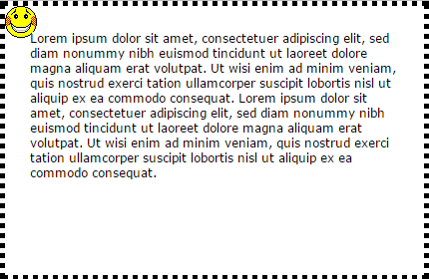
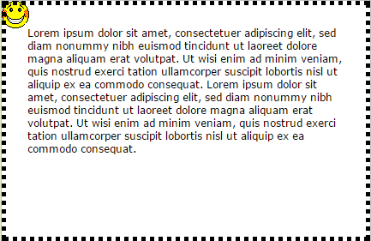
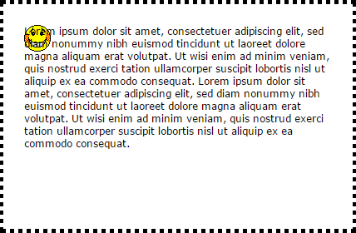
Multiple Background Images
padding-box
border-box
content-box
Ref :http://www.w3schools.com/cssref/playit.asp?filename=playcss_background-origin&preval=content-box

Slide 40
Reflections
-webkit-box-reflect property
direction
above, below, left, right
offset (determines the space between the image and its reflection)
gradient (option)
available only in WebKit-based browsers
Web Resource
http://designshack.net/articles/css/mastering-css-reflections-in-webkit/
http://css3clickchart.com/#reflections

Slide 41
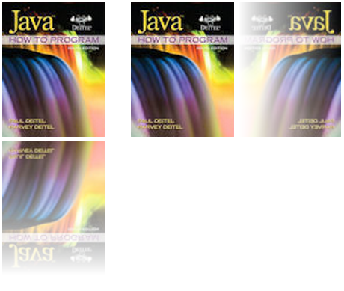

Reflections
<!DOCTYPE html>
<html>
<head>
<meta charset = "utf-8">
<title>Reflection</title>
<style type = "text/css">
img { margin-right: 30px; }
img.below
{
-webkit-box-reflect: below 5px
-webkit-gradient(
linear, left top, left bottom,
from(transparent), to(white));
}
img.right
{
-webkit-box-reflect: right 5px
-webkit-gradient(
linear, right top, left top,
from(transparent), to(white));
}
</style>
</head>
<body>
<img class = "below" src = "jhtp.png" width = "138" height = "180"
alt = "Java How to Program book cover">
<img class = "right" src = "jhtp.png" width = "138" height = "180"
alt = "Java How to Program book cover">
</body>
</html>
5px
jhtp.png

Slide 42
Image Borders
The CSS3 border-image property uses images to place a border around any block-level element.
Web Resource:
http://border-image.com/
https://developer.mozilla.org/en-US/docs/Web/CSS/Tools/Border-image_generator

Slide 43
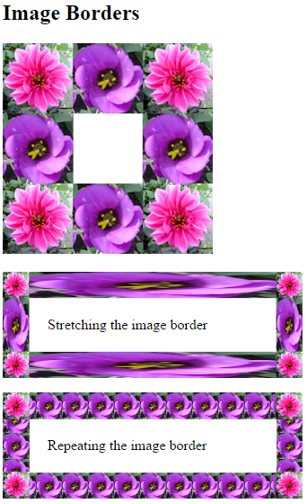
<!DOCTYPE html>
<html>
<head>
<meta charset = "utf-8">
<title>Image Border</title>
<style type = "text/css">
div
{
border-width: 30px;
width: 234px;
padding: 20px 20px;
}
#stretch
{
-webkit-border-image: url(border.png) 80 80 80 80 stretch;
-moz-border-image: url(border.png) 80 80 80 80 stretch;
-o-border-image: url(border.png) 80 80 80 80 stretch;
border-image: url(border.png) 80 80 80 80 stretch;
}
#repeat
{
-webkit-border-image: url(border.png) 34% 34% repeat;
-moz-border-image: url(border.png) 34% 34% repeat;
-o-border-image: url(border.png) 34% 34% repeat;
border-image: url(border.png) 34% 34% repeat;
}
</style>
</head>
<body>
<h2>Image Borders</h2>
<img src = "border.png" alt = "image used to demonstrate borders">
<p><div id = "stretch">Stretching the image border</div></p>
<p><div id = "repeat">Repeating the image border</div></p>
</body>
</html>

Slide 44
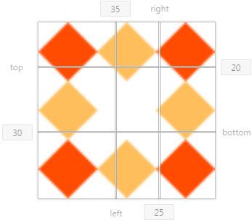
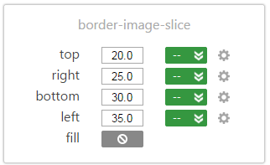
Image Borders
-webkit-border-image: url(border.png) 80 80 80 80 stretch;
-moz-border-image: url(border.png) 80 80 80 80 stretch;
-o-border-image: url(border.png) 80 80 80 80 stretch;
border-image: url(border.png) 80 80 80 80 stretch;
border-image: <'border-image-source'> || <'border-image-slice'> [ / <'border-image-width'> | / <'border-image-width'>? / <'border-image-outset'> ]? || <'border-image-repeat'>

Slide 45
Image Borders
border-image-source
the image to use instead of the style of the border
border-image-slice
expressed with four space-separated values in pixels. These values are the inward offsets from the top, right, bottom and left sides of the image.
The border-image-slice divides the image into nine regions: four corners, four sides and a middle, which is transparent unless otherwise specified.
border-image-slice : 10px; /* 上下左右皆 10px */
border-image-slice : 10px 20px; /* 上下 10px 左右 20px */
border-image-slice : 10px 20px 30px; /* 上 10px 左右 20px 下 30px */
border-image-slice : 10px 20px 30px 40px; /* 上 10px 右 20px 下 30px 左 40px */

Slide 46
Image Borders
border-image-width
the width of the border
border-image-outset
describes by which amount the border image area extends beyond the border box
border-image-repeat
specifies how the regions of the border image are scaled and tiled (repeated)
stretch
repeat
round

Slide 47
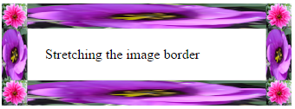
Image Borders
border-width: 30px;
border-image: url(border.png) 80 80 80 80 stretch;
border-image-source: url("border.png");
border-image-slice: 80 80 80 80;
border-image-width: 30px 30px 30px 30px;
border-image-outset: 0px 0px 0px 0px;
border-image-repeat: stretch stretch;

Slide 48

Animation; Selectors
<!DOCTYPE html>
<html>
<head>
<meta charset = "utf-8">
<title>Animation</title>
<style type = "text/css">
img
{
position: relative;
-webkit-animation: movingimage linear 10s 1s 2 alternate;
-moz-animation: movingimage linear 10s 1s 2 alternate;
animation: movingimage linear 10s 1s 2 alternate;
}
@-webkit-keyframes movingimage
{
0% {opacity: 0; left: 50px; top: 0px;}
25% {opacity: 1; left: 0px; top: 50px;}
50% {opacity: 0; left: 50px; top: 100px;}
75% {opacity: 1; left: 100px; top: 50px;}
100% {opacity: 0; left: 50px; top: 0px;}
}
@-moz-keyframes movingimage
{
0% {opacity: 0; left: 50px; top: 0px;}
25% {opacity: 1; left: 0px; top: 50px;}
50% {opacity: 0; left: 50px; top: 100px;}
75% {opacity: 1; left: 100px; top: 50px;}
100% {opacity: 0; left: 50px; top: 0px;}
}
@keyframes movingimage
{
0% {opacity: 0; left: 50px; top: 0px;}
25% {opacity: 1; left: 0px; top: 50px;}
50% {opacity: 0; left: 50px; top: 100px;}
75% {opacity: 1; left: 100px; top: 50px;}
100% {opacity: 0; left: 50px; top: 0px;}
}
</style>
</head>
<body>
<img src = "jhtp.png" width = "138" height = "180"
alt = "Java How to Program book cover">
</body>
</html>
0%-25%
75%-100%
25%-50%
50%-75%

Slide 49
Animation; Selectors
img
{
position: relative;
-webkit-animation: movingimage linear 10s 1s 2 alternate;
-moz-animation: movingimage linear 10s 1s 2 alternate;
animation: movingimage linear 10s 1s 2 alternate;
}
@-webkit-keyframes movingimage
{
0% {opacity: 0; left: 50px; top: 0px;}
25% {opacity: 1; left: 0px; top: 50px;}
50% {opacity: 0; left: 50px; top: 100px;}
75% {opacity: 1; left: 100px; top: 50px;}
100% {opacity: 0; left: 50px; top: 0px;}
}
函式名稱, 變化方式, 動畫時間, 延遲時間, 動畫次數, 方向
animation-name: movingImage;
animation-timing-function: linear;
animation-duration: 10s;
animation-delay: 1s;
animation-iteration-count: 2;
animation-direction: alternate;

Slide 50
Animation; Selectors
animation-name
the name of the keyframe you want to bind to the selector
animation-timing-function
determines how the animation progresses in one cycle of its duration
Possible values
linear : the animation will move at the same speed from start to finish
ease : starts slowly, increases speed, then ends slowly
ease-in : starts slowly, then speeds
ease-out : starts faster, then slows down
ease-in-out : starts and ends slowly
cubic-bezier : allows you to customize the timing function with four values between 0 and 1, such as cubic-bezier(1,0,0,1)
http://cubic-bezier.com/

Slide 51
Animation; Selectors
animation-duration
the time in seconds (s) or milliseconds (ms) that the animation takes to complete one iteration
animation-delay
the number of seconds or milliseconds after the page loads before the animation begins.
animation-iteration-count
the number of times the animation will run.
You may use the value infinite to repeat the animation continuously.

Slide 52
Animation; Selectors
animation-direction
the direction in which the animation will run.
Possible values
normal
The animation should be played as normal
reverse
The animation should play in reverse direction
alternate
The animation will run in alternating directions
alternate-reverse
The animation will run in alternating directions and play in reverse direction

Slide 53
Animation; Selectors
animation-play-state
Possible values
paused
Specifies that the animation is paused
running
Specifies that the animation is running
The shorthand animation property cannot be used with it.
-webkit-animation: movingimage linear 10s 1s 2 alternate;

Slide 54
Animation; Selectors
@keyframes Rule and Selectors
The @keyframes rule defines the element’s properties that will change during the animation, the values to which those properties will change, and when they’ll change.
The @keyframes rule is followed by the name of the animation to which the keyframes are applied.
CSS rules consist of one or more selectors followed by a declaration block in curly braces ({}).
Selectors enable you to apply styles to elements of a particular type or attribute.
from (same as 0%)
to (same as 100%)

Slide 55
Animation; Selectors
Web Resource
http://www.w3schools.com/css/tryit.asp?filename=trycss3_animation4
http://www.w3schools.com/cssref/tryit.asp?filename=trycss3_keyframes
https://developer.mozilla.org/en-US/docs/Web/CSS/animation

Slide 56
Exercise
div#box
{
width : 50px;
height : 50px;
border-radius: 25px;
position: relative;
background : -webkit-radial-gradient(center,navy,white);
…
}
<body>
<div id="box"></div>
</body>

Slide 57
Transitions and Transformations
With CSS3 transitions, you can change an element’s style over a specified duration.
CSS3 transformations allow you to move, rotate, scale and skew elements.
Transitions are similar in concept to the animations, but transitions allow you to specify only the starting and ending values of the CSS properties being changed.
An animation’s keyframes enable you to control intermediate states throughout the animation’s duration.

Slide 58




Transitions and Transformations
<!DOCTYPE html>
<html>
<head>
<meta charset = "utf-8">
<title>Transitions</title>
<style type = "text/css">
img
{
margin: 80px;
-webkit-transition: -webkit-transform 4s;
-moz-transition: -moz-transform 4s;
-o-transition: -o-transform 4s;
transition: transform 4s;
}
img:hover
{
-webkit-transform: rotate(360deg) scale(2, 2);
-moz-transform: rotate(360deg) scale(2, 2);
-o-transform: rotate(360deg) scale(2, 2);
transform: rotate(360deg) scale(2, 2);
}
</style>
</head>
<body>
<img src = "cpphtp.png" width = "76" height = "100"
alt = "C++ How to Program book cover">
</body>
</html>

Slide 59
Transitions and Transformations
transition-property
Specifies the name of the CSS property the transition effect is for
transition-duration
transition-timing-function
transition-delay
syntax: [ none | <transition-property>] || < transition-duration > || < transition-timing-function > || < transition-delay >
-webkit-transition-property: -webkit-transform
-webkit-transition-duration: 4s
-webkit-transition-timing-function: linear
-webkit-transition-delay: 0s

Slide 60
Transitions and Transformations
rotate property
the number of degrees
Negative values cause the element to rotate left
scale property
specifies how to scale the width and height
The value 1 represents the original width or original height, so values greater than 1 increase the size and values less than 1 decrease the size.
Web Resource
http://www.w3schools.com/cssref/css3_pr_transform.asp

Slide 61
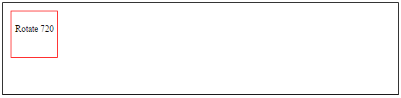

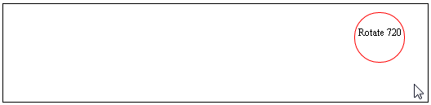
Exercise
#box1 {
position:relative;
width:500px;
height:100px;
margin:0 auto 10px;
border:1px solid black;
padding:10px;
}
#box2 {
font-size:12px;
position:relative;
width:60px;
height:60px;
-webkit-transition: …
}
#box2 p {
text-align:center;
padding-top:4px;
}
#box1:hover #box2 {
margin-left:420px;
-webkit-border-radius: …
-webkit-transform: …
}
<div id="box1">
<div id="box2"><p>Rotate 720</p></div>
</div>

Slide 62
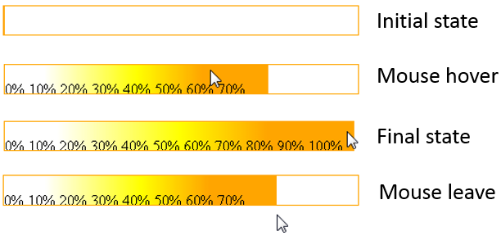
Exercise
#box1
{
border: 1px solid orange;
height : 30px;
width : 370px;
...
}
#box2
{
height : 30px;
width : 0px;
margin : -1px;
border: 1px solid orange;
...
}
<body>
<div id="box1">
<div id="box2">
<p> 0% 10% 20% 30% 40% 50% 60% 70% 80% 90% 100%</p>
</div>
</div>
</body>

Slide 63
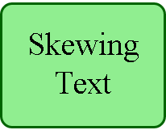
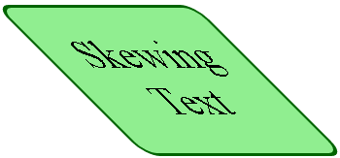
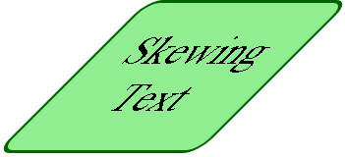
Skew
<!DOCTYPE html>
<html>
<head>
<meta charset = "utf-8">
<title>Skew</title>
<style type = "text/css">
.skew .textbox
{
margin-left: 75px;
background: lightgreen;
height: 100px;
width: 200px;
padding: 25px 0;
text-align: center;
font-size: 250%;
border: 3px solid DarkGreen;
border-radius:15px;
-webkit-animation: skew 3s infinite linear;
-moz-animation: skew 3s infinite linear;
animation: skew 3s infinite linear;
}
@-webkit-keyframes skew
{
from { -webkit-transform: skewX(0deg); }
25% { -webkit-transform: skewX(45deg); }
50% { -webkit-transform: skewX(0); }
75% { -webkit-transform: skewX(-45deg); }
to { -webkit-transform: skewX(0); }
}
animation: skew 3s infinite linear;
animation-name:skew;
animation-duration: 3s;
animation-iteration-count: infinite;
animation-timing-function: linear;
from , 50%, to
25%
75%

Slide 64
Skew
@-moz-keyframes skew
{
from { -moz-transform: skewX(0deg); }
25% { -moz-transform: skewX(45deg); }
50% { -moz-transform: skewX(0); }
75% { -moz-transform: skewX(-45deg); }
to { -moz-transform: skewX(0); }
}
@keyframes skew
{
from { transform: skewX(0deg); }
25%{ transform: skewX(45deg); }
50%{ transform: skewX(0); }
75%{ transform: skewX(-45deg); }
to { transform: skewX(0); }
}
</style>
</head>
<body>
<div class = "box skew">
<div class = "textbox">Skewing Text</div>
</div>
</body>
</html>

Slide 65
Skew
CSS3 transformations also allow you to skew block-level elements, slanting them at an angle either horizontally (skewX) or vertically (skewY).

Slide 66


Transitioning Between Images
<!DOCTYPE html>
<html>
<head>
<meta charset = "utf-8">
<title>Melting Images</title>
<style type = "text/css">
#cover
{
position: relative;
margin: 0 auto;
}
#cover img
{
position: absolute;
left: 0;
-webkit-transition: opacity 4s ease-in-out;
transition: opacity 4s ease-in-out;
}
#cover img.top:hover
{ opacity:0; }
</style>
</head>
<body>
<div id= "cover">
<img class = "bottom" src = "jhtp.png" alt = "Java 9e cover">
<img class = "top" src = "jhtp8.png" alt = "Java 8e cover">
</div>
</body>
</html>
-webkit-transition: opacity 4s ease-in-out;
-webkit-transition-property: opacity
-webkit-transition-duration: 4s
-webkit-transition-timing-function: ease-in-out
jhtp.png
jhtp8.png

Slide 67
Animation v.s Transitions
Similarities
Specify which CSS properties to listen for changes on
Set timing (easing) functions to alter the rate of going from a one property value to another
Specify a duration to control how long the animation or transition will take
Programmatically listen to animation and transition-specific events that you can then do with as you wish

Slide 68
Animation v.s Transitions
Differences
Triggering
Animations don't require any explicit triggering.
Transition only plays as a reaction to a CSS property that has changed.
Looping
animation-iteration-count property
transition don't have a property

Slide 69
Animation v.s Transitions
Differences
Defining Intermediate Points / Keyframes
animation : you have the ability to define keyframes which give you more control over your CSS property values beyond just the start and the end.
transitions : you don't have much control over anything beyond the end result

Slide 70
Downloading Web Fonts and the @font-face Rule
Using the @font-face rule, you can specify fonts for a web page, even if they’re not installed on the user's system.
You can use downloadable fonts to help ensure a uniform look across client sites.
Web Resource
http://www.google.com/fonts/

Slide 71
Downloading Web Fonts and the @font-face Rule
<!DOCTYPE html>
<html>
<head>
<meta charset = "utf-8">
<title>Embedded Fonts</title>
<link href = 'http://fonts.googleapis.com/css?family=Calligraffitti'
rel = 'stylesheet' type='text/css'>
<style type = "text/css">
body
{
font-family: "Calligraffitti";
font-size: 48px;
text-shadow: 3px 3px 3px DimGrey;
}
</style>
</head>
<body>
<div>
<b>Embedding the Google web font "Calligraffitti"</b>
</div>
</body>
</html>
http://fonts.googleapis.com/css?family=Calligraffitti
/* latin */
@font-face {
font-family: 'Calligraffitti';
font-style: normal;
font-weight: 400;
src: local('Calligraffitti'), local('Calligraffitti-Regular'), url(http://fonts.gstatic.com/s/calligraffitti/v7/vLVN2Y-z65rVu1R7lWdvyHgb5cXjTnFmJ5DL9C8eNek.woff2) format('woff2');
unicode-range: U+0000-00FF, U+0131, U+0152-0153, U+02C6, U+02DA, U+02DC, U+2000-206F, U+2074, U+20AC, U+2212, U+2215, U+E0FF, U+EFFD, U+F000;
}

Slide 72
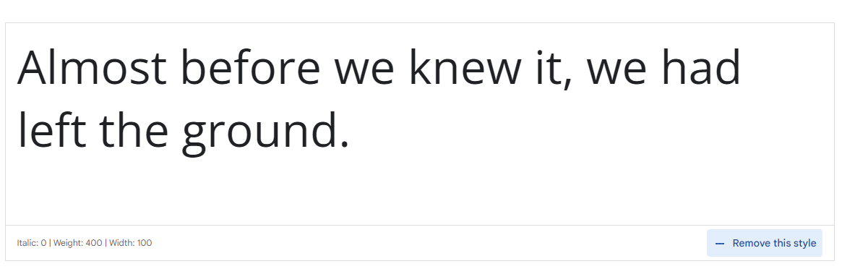
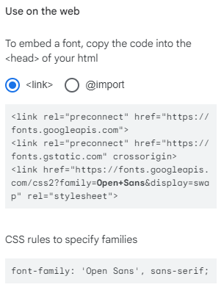
Downloading Web Fonts and the @font-face Rule
http://www.google.com/fonts/

Slide 73
Flexible Box Layout Module and :nth-child Selectors
Flexible Box Layout Module (FBLM) makes it easy to align the contents of boxes, change their size, change their order dynamically, and lay out the contents in any direction.

Slide 74
Flexible Box Layout Module and :nth-child Selectors
<!DOCTYPE html>
<html>
<head>
<meta charset = "utf-8">
<title>Flexible Box Layout Model</title>
<link href = 'http://fonts.googleapis.com/css?family=Rosario' rel = 'stylesheet' type = 'text/css'>
<style type = "text/css">
.flexbox
{
width: 600px;
height: 420px;
display: -webkit-box;
display: box;
-webkit-box-orient: horizontal;
box-orient: horizontal;
}
.flexbox > div
{
-webkit-transition: 1s ease-out;
transition: 1s ease-out;
-webkit-border-radius: 10px;
border-radius: 10px;
border: 2px solid black;
width: 120px;
margin: 10px -10px 10px 0px;
padding: 20px 20px 20px 20px;
box-shadow: 10px 10px 10px dimgrey;
}
.flexbox > div:nth-child(1){ background-color: lightgrey; }
.flexbox > div:nth-child(2){ background-color: lightgrey; }
.flexbox > div:nth-child(3){ background-color: lightgrey; }
.flexbox > div:nth-child(4){ background-color: lightgrey; }
.flexbox > div:hover {
width: 200px; color: white; font-weight: bold; }
.flexbox > div:nth-child(1):hover { background-color: royalblue; }
.flexbox > div:nth-child(2):hover { background-color: crimson; }
.flexbox > div:nth-child(3):hover { background-color: crimson; }
.flexbox > div:nth-child(4):hover { background-color: darkgreen; }
p { height: 250px; overflow: hidden; font-family: "Rosario" }
</style>
</head>
div用box的方式呈現
排列方式為水平
.flexbox > div: flexbox裡的div
-webkit-transition: 1s ease-out;
-webkit-transition-duration: 1s
-webkit-transition-timing-function: ease-out
> :child selector

Slide 75
Flexible Box Layout Module and :nth-child Selectors
<body>
<div class = "flexbox">
<div><img src = "GPP.png" alt = "Good programming practice icon">
<p>Good Programming Practices call attention to techniques that
will help you produce programs that are clearer, more
understandable and more maintainable.</p></div>
<div><img src = "EPT.png" alt = "Error prevention tip icon">
<p>Error-Prevention Tips contain suggestions for exposing bugs
and removing them from your programs; many describe aspects of
programming that prevent bugs from getting into programs in
the first place.</p></div>
<div><img src = "CPE.png" alt = "Common programming error icon">
<p>Common Programming Errors point out the errors that students
tend to make frequently. These Common Programming Errors reduce
the likelihood that you'll make the same mistakes.</p></div>
<div><img src = "SEO.png"
alt = "Software engineering observation icon"><p>Software
Engineering Observations highlight architectural and design
issues that affect the construction of software systems,
especially large-scale systems.</p></div>
</div>
</body>
</html>

Slide 76



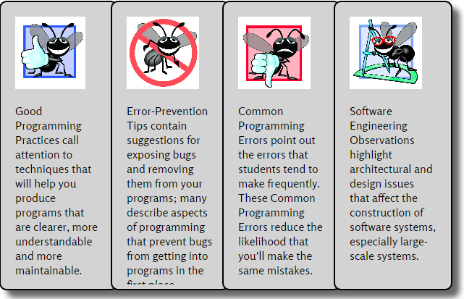
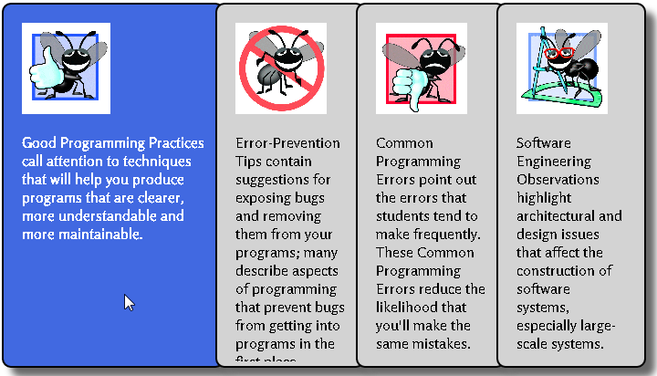

Flexible Box Layout Module and :nth-child Selectors
.flexbox > div:hover { width: 200px; color: white; font-weight: bold; }
.flexbox > div:nth-child(1):hover { background-color: royalblue; }
.flexbox > div:nth-child(2):hover { background-color: crimson; }
.flexbox > div:nth-child(3):hover { background-color: crimson; }
.flexbox > div:nth-child(4):hover { background-color: darkgreen; }
<body>
<div class = "flexbox">
<div><img src = "GPP.png" alt = "Good programming practice icon">
<p>Good Programming ...</p></div>
<div><img src = "EPT.png" alt = "Error prevention tip icon">
<p>Error-Prevention ...</p></div>
<div><img src = "CPE.png" alt = "Common programming error icon">
<p>Common Programming ...</p></div>
<div><img src = "SEO.png" alt = "Software engineering observation icon">
<p>Software Engineering ...</p></div>
</div>
</body>
GPP.png
EPT.png
CPE.png
SEO.png

Slide 77
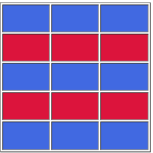
:nth-child Selectors
<!DOCTYPE html>
<html>
<head>
<meta charset = "utf-8">
<title>nth-child</title>
<style type = "text/css">
table
{
width : 200px;
height : 200px;
}
tr:nth-child(odd){ background-color:royalblue;}
tr:nth-child(even){ background-color:crimson; }
</style>
</head>
<body>
<table border="1">
<tr><td>&nbsp;</td><td>&nbsp;</td><td>&nbsp;</td></tr>
<tr><td>&nbsp;</td><td>&nbsp;</td><td>&nbsp;</td></tr>
<tr><td>&nbsp;</td><td>&nbsp;</td><td>&nbsp;</td></tr>
<tr><td>&nbsp;</td><td>&nbsp;</td><td>&nbsp;</td></tr>
<tr><td>&nbsp;</td><td>&nbsp;</td><td>&nbsp;</td></tr>
</table>
</body>
</html>

Slide 78
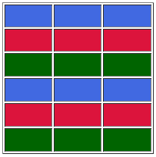
:nth-child Selectors
<!DOCTYPE html>
<html>
<head>
<meta charset = "utf-8">
<title>nth-child</title>
<style type = "text/css">
table
{
width : 200px;
height : 200px;
}
tr:nth-child(3n+1) { background-color:royalblue; }
tr:nth-child(3n+2) { background-color:crimson; }
tr:nth-child(3n) { background-color:darkgreen; }
</style>
</head>
<body>
<table border="1">
<tr><td>&nbsp;</td><td>&nbsp;</td><td>&nbsp;</td></tr>
<tr><td>&nbsp;</td><td>&nbsp;</td><td>&nbsp;</td></tr>
<tr><td>&nbsp;</td><td>&nbsp;</td><td>&nbsp;</td></tr>
<tr><td>&nbsp;</td><td>&nbsp;</td><td>&nbsp;</td></tr>
<tr><td>&nbsp;</td><td>&nbsp;</td><td>&nbsp;</td></tr>
<tr><td>&nbsp;</td><td>&nbsp;</td><td>&nbsp;</td></tr>
</table>
</body>
</html>

Slide 79
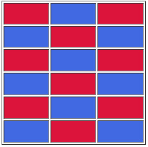
Exercise
table
{
width : 200px;
height : 200px;
}
tr:nth-child(…) > td:nth-child(…) {background-color:royalblue;}
tr:nth-child(…) > td:nth-child(…) {background-color:crimson;}
…

Slide 80
div img v.s div > img
div img : ok
div > img :miss
Note: ">" : must child element
<body>
<div>
<p><img> </p>
</div>
</body>

Slide 81
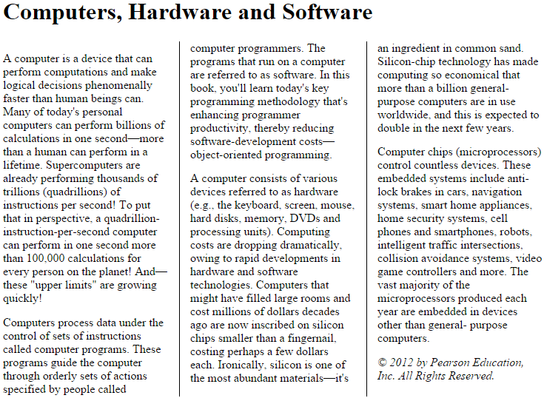
Multicolumn Layout
<!DOCTYPE html>
<html>
<head>
<meta charset = "utf-8">
<title>Multicolumns</title>
<style type = "text/css">
p { margin:0.9em 0em; }
.multicolumns
{
/* setting the number of columns to 3 */
-webkit-column-count: 3;
-moz-column-count: 3;
-o-column-count: 3;
column-count: 3;
/* setting the space between columns to 30px */
-webkit-column-gap: 30px;
-moz-column-gap: 30px;
-o-column-gap: 30px;
column-gap: 30px;
/* adding a 1px black line between each column */
-webkit-column-rule: 1px outset black;
-moz-column-rule: 1px outset black;
-o-column-rule: 1px outset black;
column-rule: 1px outset black;
}
</style>
</head>
<body>
<header><h1>Computers, Hardware and Software<h1/></header>
<div class = "multicolumns">
<p>A computer is a device that can perform computations and make logical decisions phenomenally faster than human beings can. Many of today's personal computers can perform billions of calculations in one second&mdash;more than a human can perform in a lifetime. Supercomputers are already performing thousands of trillions (quadrillions) of instructions per second! To put that in perspective, a quadrillion-instruction-per-second computer can perform in one second more than 100,000 calculations for every person on the planet! And&mdash;these "upper limits" are growing quickly!</p>
<p>Computers process data under the control of sets of instructions called computer programs. These programs guide the computer through orderly sets of actions specified by people called computer programmers. The programs that run on a computer are referred to as software. In this book, you'll learn today's key programming methodology that's enhancing programmer productivity, thereby reducing software-development costs&mdash;object-oriented programming.</p>
<p>A computer consists of various devices referred to as hardware (e.g., the keyboard, screen, mouse, hard disks, memory, DVDs and processing units). Computing costs are dropping dramatically, owing to rapid developments in hardware and software technologies. Computers that might have filled large rooms and cost millions of dollars decades ago are now inscribed on silicon chips smaller than a fingernail, costing perhaps a few dollars each. Ironically, silicon is one of the most abundant materials&mdash;it's an ingredient in common sand. Silicon-chip technology has made computing so economical that more than a billion general-purpose computers are in use worldwide, and this is expected to double in the next few
years.</p>
<p>Computer chips (microprocessors) control countless devices. These embedded systems include anti-lock brakes in cars, navigation systems, smart home appliances, home security systems, cell phones and smartphones, robots, intelligent traffic intersections, collision avoidance systems, video game controllers and more. The vast majority of the microprocessors produced each year are embedded in devices other than general-purpose computers.</p>
<footer><em>&copy; 2012 by Pearson Education, Inc. All Rights Reserved.</em></footer>
</div>
</body>
</html>

Slide 82
Multicolumn Layout
<style type = "text/css">
p { margin:0.9em 0em; }
.multicolumns
{
/* setting the number of columns to 3 */
-webkit-column-count: 3;
-moz-column-count: 3;
-o-column-count: 3;
column-count: 3;
/* setting the space between columns to 30px */
-webkit-column-gap: 30px;
-moz-column-gap: 30px;
-o-column-gap: 30px;
column-gap: 30px;
/* adding a 1px black line between each column */
-webkit-column-rule: 1px outset black;
-moz-column-rule: 1px outset black;
-o-column-rule: 1px outset black;
column-rule: 1px outset black;
}
</style>
column-count : 總共幾欄
column-gap : 兩欄之間距離
column-rule: 分隔線樣式

Slide 83
Q&A

